Slide 1
FU TIMETABLING

Slide 2
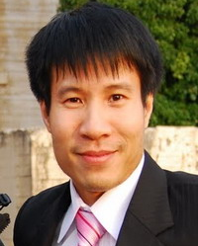
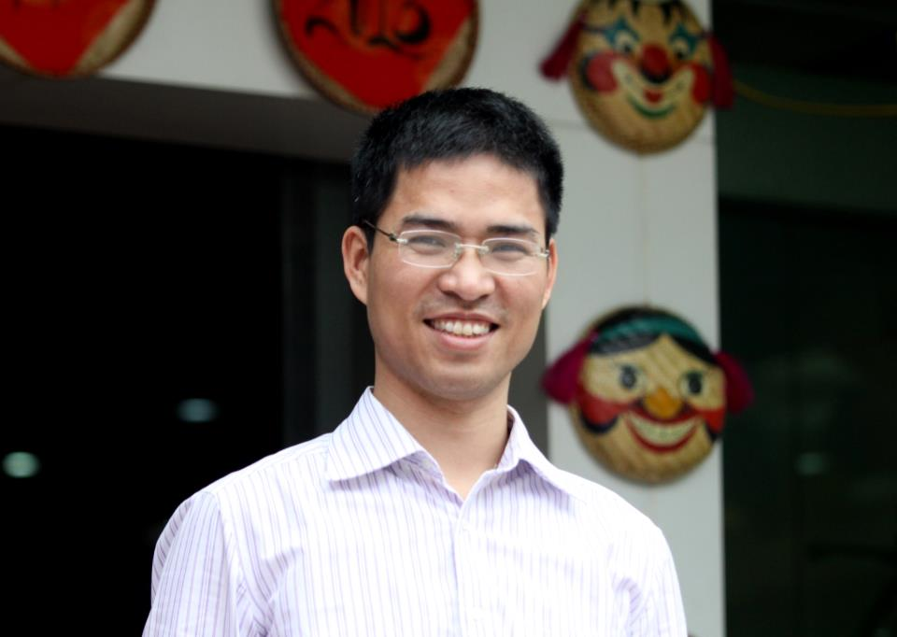
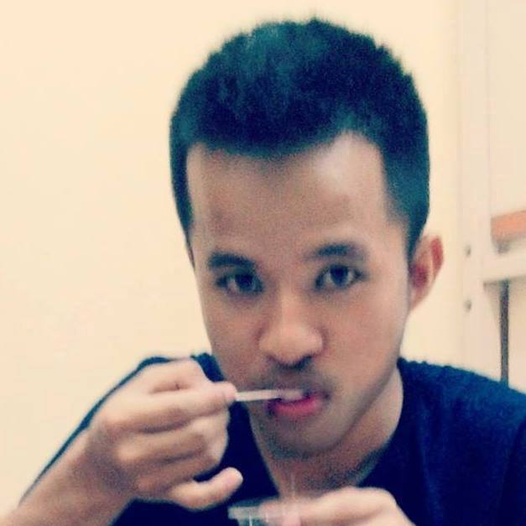
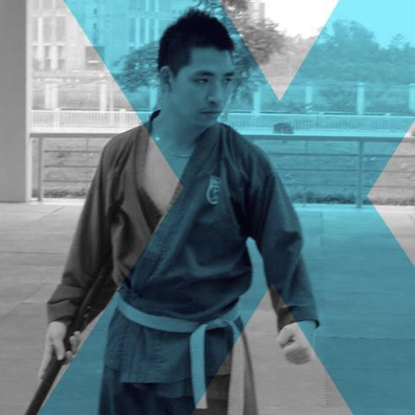
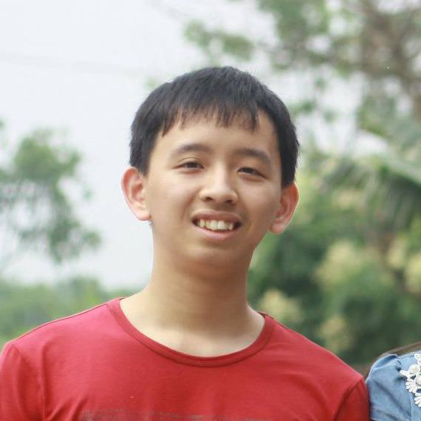

TEAM MEMBERS
SUPERVISORS
Mr. DungPQ
Mr. TrungNT
Team

Slide 3
CONTENTS
OVERVIEW
OUR APPROACH
ALGORITHM DETAILS
RESULT AND EXPERIMENTS
CONCLUSION
DEMO

Slide 4
OVERVIEW
SUN | MON | TUE | WED | THU | FRI | SAT

Slide 5
FU’s Current
Manual scheduling process
Parition classes
Schedule
& Assign rooms
Merge classes
Assign teachers
Timetable

Slide 6
FU’s Current (cont)
Challenging:
Part-time teachers
More campuses
Split classes, merge classes
Room constancy
Share teachers
Non-pass students
Condition courses
…

Slide 7
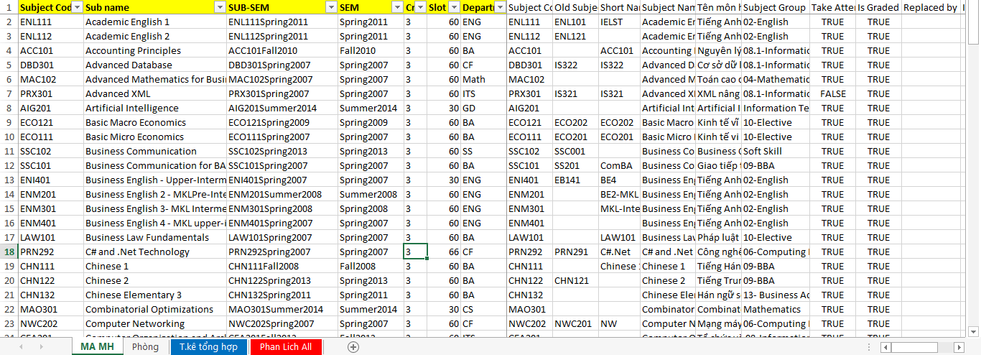
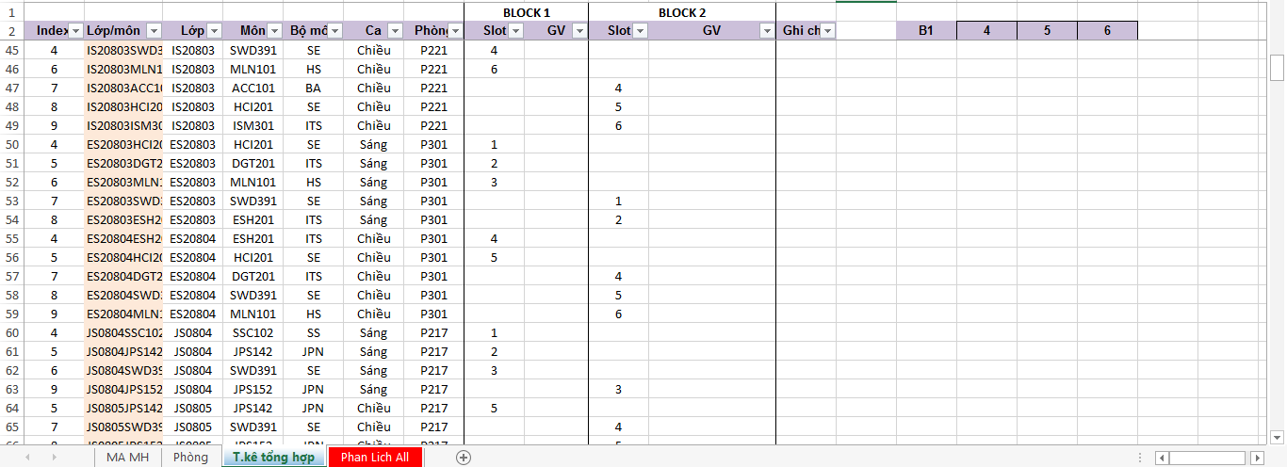
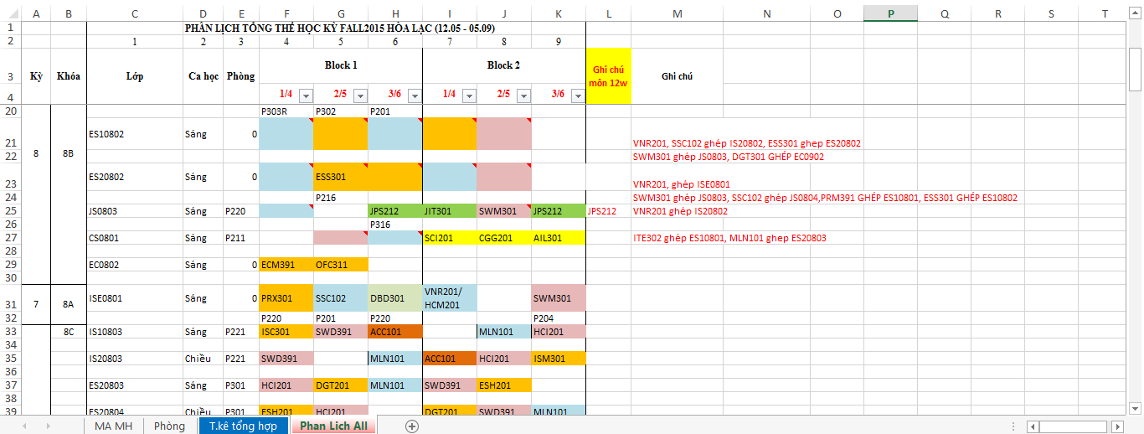
FU’s Current (cont)
Challenging (cont):

Slide 8
OUR WORK

Slide 9

OUR WORK

Slide 10
OVERVIEW
SUN | MON | TUE | WED | THU | FRI | SAT

Slide 11
OVERVIEW
SUN | MON | TUE | WED | THU | FRI | SAT

Slide 12
OVERVIEW
SUN | MON | TUE | WED | THU | FRI | SAT

Slide 13


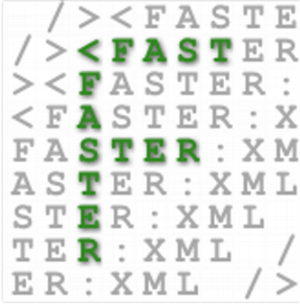







TECHNOLOGIES
SPRING
MySQL 5.6
FXML
SPRING DATA
LOG4J
Choco
Tomcat
Hibernate
POI
Open-cbls

